Slide 1


HERizon - Security Intelligence
AI-Powered Security Automation Platform with Shadow IT Prevention and Access Management Solutions

Slide 2
HERizon Team Information
Seema Gupta - Project Lead & AI, Cybersecurity Specialist Email: guptaseema578@gmail.com
Anayna Singh - Technical Director : Email: anaynasingh8@gmail.com
Sneha Joshi - Software and AI Engineer : Email: sjoshi32@hawk.illinoistech.edu
Meghana Rabba - AI Architect : Email: meghrabba@gmail.com
Deepali Budhiraja - Cloud Infrastructure Engineer : Email: deepalibudhiraja0924@gmail.com

Slide 3
Introduction
Modern enterprises rely on hundreds of SaaS applications, distributed teams, and dynamic access needs—creating a cybersecurity environment that is faster, more complex, and more unpredictable than ever before. As organizations scale, two major challenges rapidly emerge:
Shadow IT, where employees adopt unapproved tools without visibility or oversight, exposing the organization to hidden risks, data leakage, and compliance violations.
Inefficient access management, where approval workflows are manual, inconsistent, and slow, creating operational bottlenecks and governance gaps.
To address these challenges, we built an AI-Powered Security Automation Platform that integrates two advanced systems:
ASIPD (AI Shadow IT Prevention Desk) – an intelligent multi-agent engine that detects unauthorized SaaS usage, calculates risk, maps policies, and automatically enforces secure actions.
AMAS (Access Management Agent Suite) – a fully automated access governance pipeline that evaluates user roles, risk levels, licensing availability, and tool duplication before granting or escalating software access requests.
By combining Azure AI Studio’s multi-agent capabilities, Microsoft Defender telemetry, Orchestration pipelines, and automated enforcement workflows, this platform replaces manual intervention with smart, consistent, and scalable automation. It ensures that employees use the right tools securely, and that every access decision is risk-aware, compliant, and fully traceable.

Slide 4
Enterprise environments today face three major challenges:
01. Shadow IT Explosion
Unapproved SaaS apps, browser plugins, OAuth grants, and external tools expose organizations to data loss, compliance violations, and credential abuse.Shadow IT accounts for a growing percentage of security incidents.
Problem Statement
02. Slow, Manual Access Approvals
Security teams depend on spreadsheets, emails, and fragmented workflows, causing delays, inconsistent decisions, and lack of audit trails.
03. Lack of Automated Governance
Even when detections exist (e.g., Defender logs), organizations struggle to translate them into automatic, policy-driven actions.

Slide 5



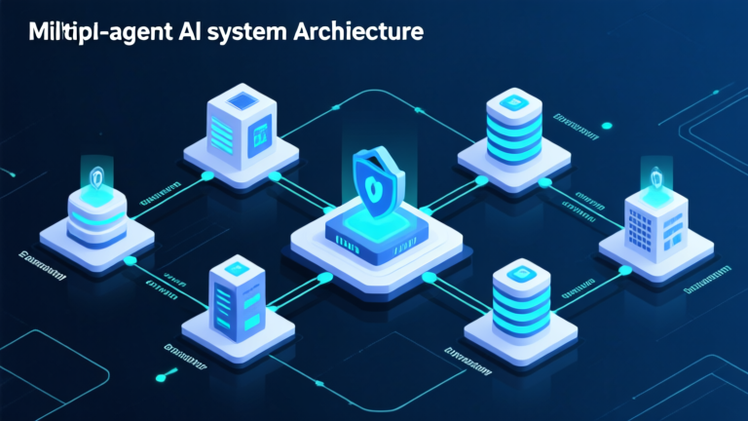
Solution Overview
Enterprise Security Intelligence
HERizon is an AI-driven security automation platform designed to identify, evaluate, and manage security risks through specialized agent orchestration. The system integrates Microsoft Defender data with multi-agent reasoning for automated enforcement and human oversight.
AI Agent Architecture
Zero Trust Alignment
Sequential multi-agent pipeline with specialized agents for data fetching, risk analysis, policy mapping, automation, and human-style oversight for comprehensive security operations.
Continuous monitoring and verification of security posture with automated risk detection, policy enforcement, and full auditability for enterprise environments.

Slide 6




Key Features & Benefits
Automated Risk Detection
Faster Incident Triage
Continuous analysis of Microsoft Defender logs with AI-powered detection of unauthorized SaaS usage and security threats.
Reduced manual workload with accelerated incident response through automated risk scoring and policy enforcement mechanisms.
End-to-End Observability
Consistent Policy Enforcement
Complete audit trail with immutable logging, dashboard-ready JSON outputs, and clear remediation pathways for compliance reporting.
Standardized decision logic with zero-trust aligned workflows ensuring uniform security governance across the enterprise environment.

Slide 7



The Two Use Cases:
Use case 1: AI Shadow IT Prevention Desk (ASIPD)
Shadow IT Detection System
AI-powered detection and response platform designed to identify unauthorized SaaS usage, calculate security risks, map violations to policies, and execute automated response actions with comprehensive human oversight and audit capabilities.
Unapproved SaaS Detection
Risk Scoring Engine
Policy Enforcement Automation
Calculates 0-100 risk scores with impact categorization, evaluates compromise indicators, and generates security recommendations for informed decisions.
Identifies Shadow IT usage through OAuth analysis, app usage patterns, file uploads monitoring, and IP anomaly detection from Microsoft Defender logs.
Maps violations to security policies, executes automated responses including app blocking, OAuth revocation, and user suspension with audit trails.

Slide 8




Multi-Agent Pipeline: Shadow IT Detection
Data Ingestion
Defender Data Fetcher Agent collects Microsoft Defender incidents, normalizes logs, and extracts alerts, device actions, and cloud app activity data.
SaaS Detection
SaaS Detector Agent identifies unapproved SaaS tools, detects Shadow IT usage patterns, and extracts evidence from OAuth, app usage, uploads, and IP anomalies.
Risk Assessment
Risk Scoring Agent calculates comprehensive 0-100 risk scores, categorizes impact levels, evaluates indicators of compromise, and generates security recommendations.
Policy Mapping
Policy Mapping Agent maps violations to internal security policies, labels cases by approval status, identifies required controls, and provides compliance implications.
Automated Response
Automation Agent executes response actions including app blocking, OAuth revocation, user suspension, IdP blocks, and manager approval workflows with audit-ready outputs.
Human Oversight
Human Security Analyst Agent reviews automation outputs, ensures safe decisions, provides human-style reasoning, escalates critical issues, and offers SOC team recommendations.

Slide 9
Shadow IT Prevention Key Metrics
100%
24/7
0-100
6+
Threat Detection
Monitoring Coverage
Risk Score Range
AI Agents
Detection Capabilities
Risk Analysis
Automated Response
Comprehensive Shadow IT identification through multi-source analysis and pattern recognition across enterprise environments.
Advanced risk scoring engine with multi-factor analysis and categorized impact assessment for informed decision making.
Immediate automated enforcement actions with human oversight and comprehensive audit trails for compliance requirements.
●
OAuth token analysis and unauthorized app usage detection
●
0-100 risk score with impact categorization system
●
App blocking and OAuth token revocation capabilities
●
File upload monitoring and data exfiltration prevention
●
Indicators of compromise evaluation and threat assessment
●
User suspension and IdP integration for access control
●
IP anomaly detection and geographical access patterns
●
Security recommendations based on risk profile analysis
●
Manager approval workflows with escalation procedures

Slide 10
Live Demo

Slide 11
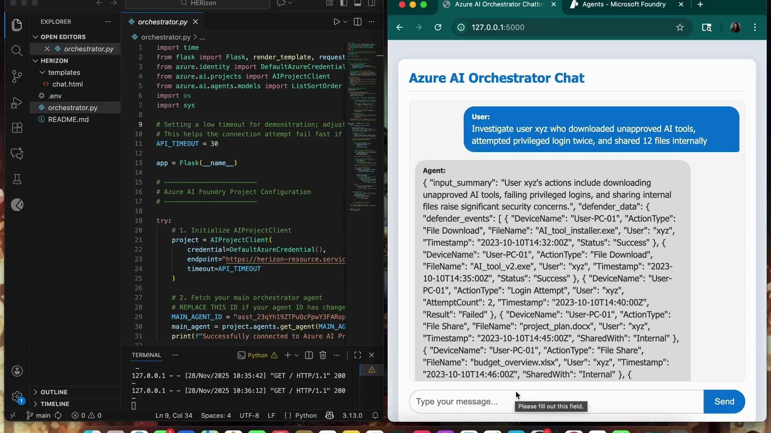

Slide 12



Use Case 2: Access Management Agent Suite
Intelligent Access Automation
AMAS automates and secures software access requests within organizations, ensuring users receive only role-appropriate access through risk assessment, license verification, audit logging, and human-in-the-loop escalation for high-risk scenarios.
Role-Based Classification
License Management
Compliance Auditing
Classifies user job titles and departments into appropriate role categories with automated access provisioning based on organizational hierarchy and responsibilities.
Tracks software seat availability, prevents license overallocation, and automatically requests additional licenses when needed for optimal resource utilization.
Maintains immutable audit logs for every access request, agent decision, risk assessment, and final outcome for regulatory compliance and security governance.

Slide 13


Multi-Agent Pipeline: Access Management
Role Classification Agent
Risk Assessment Agent
Analyzes user job titles and departments to classify users into appropriate high-level role categories, enabling automated access provisioning based on organizational structure and responsibilities.
Evaluates application fitness for user roles and determines risk levels, flagging potentially risky access requests for escalation and ensuring security-first access management decisions.
Knowledge & Audit Agents
License & Automation Agents
Identifies duplicate tools within the organization to prevent redundancy while maintaining comprehensive audit logs for compliance, tracking every request and decision.
Manages software seat availability and executes access grants/revocations via Azure AD integration, handling automatic access updates on role changes and promotions.

Slide 14
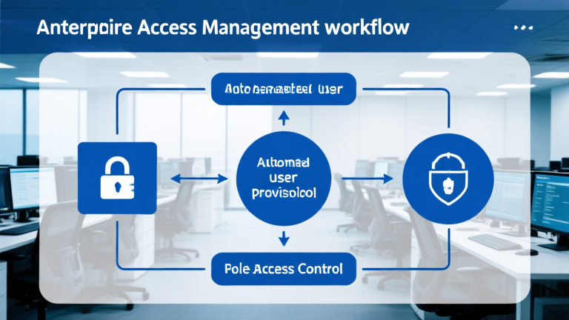

AMAS Processing Workflow
Request Submission
Risk Evaluation
Automated Processing
User submits software access request through secure portal with role verification and automatic classification into appropriate access categories.
Risk Assessment Agent evaluates application fitness, calculates risk scores, and determines if escalation to management approval is required.
License verification, duplicate tool checking, and automated access provisioning through Azure AD with comprehensive audit logging and compliance tracking.

Slide 15
AMAS Performance Metrics
95%
100%
8+
24/7
Auto-Approval Rate
Security Compliance
Agent Types
Processing Availability
Access Management
License Optimization
Audit & Compliance
Intelligent role-based access provisioning with automated classification and risk-aware decision making for enterprise security.
Comprehensive license management preventing overallocation while ensuring resource availability and cost optimization for the organization.
Complete audit trail with immutable logging ensuring regulatory compliance and providing full visibility into access decisions.
●
Job title and department classification into role categories
●
Real-time software seat availability tracking and management
●
Comprehensive logging of requests, decisions, and risk scores
●
Automated access provisioning based on organizational hierarchy
●
Automatic license request generation when seats unavailable
●
Immutable audit records stored in CosmosDB
●
Risk evaluation and escalation for high-risk requests
●
Duplicate tool identification to prevent redundant spending
●
Automated compliance reporting and dashboard analytics

Slide 16
Live Demo

Slide 17
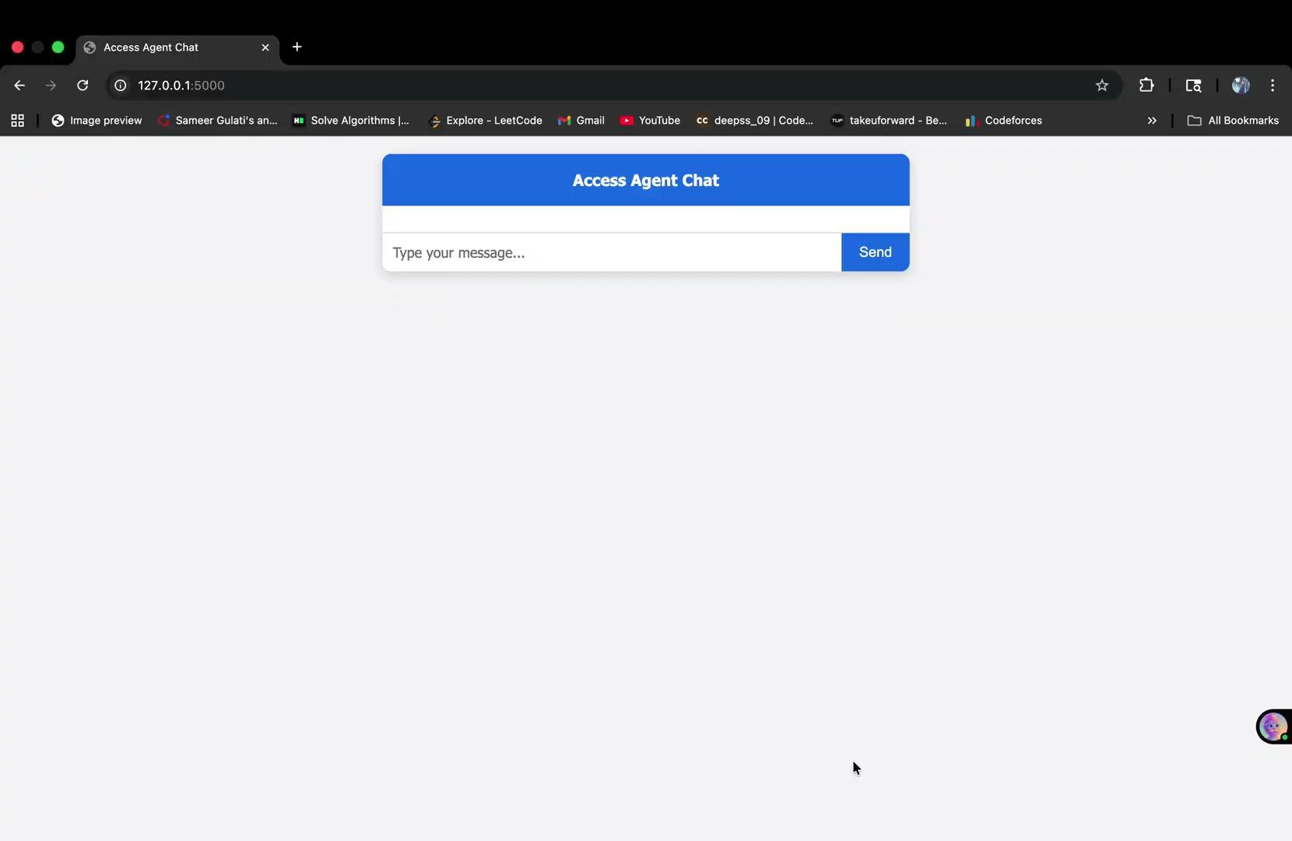

Slide 18
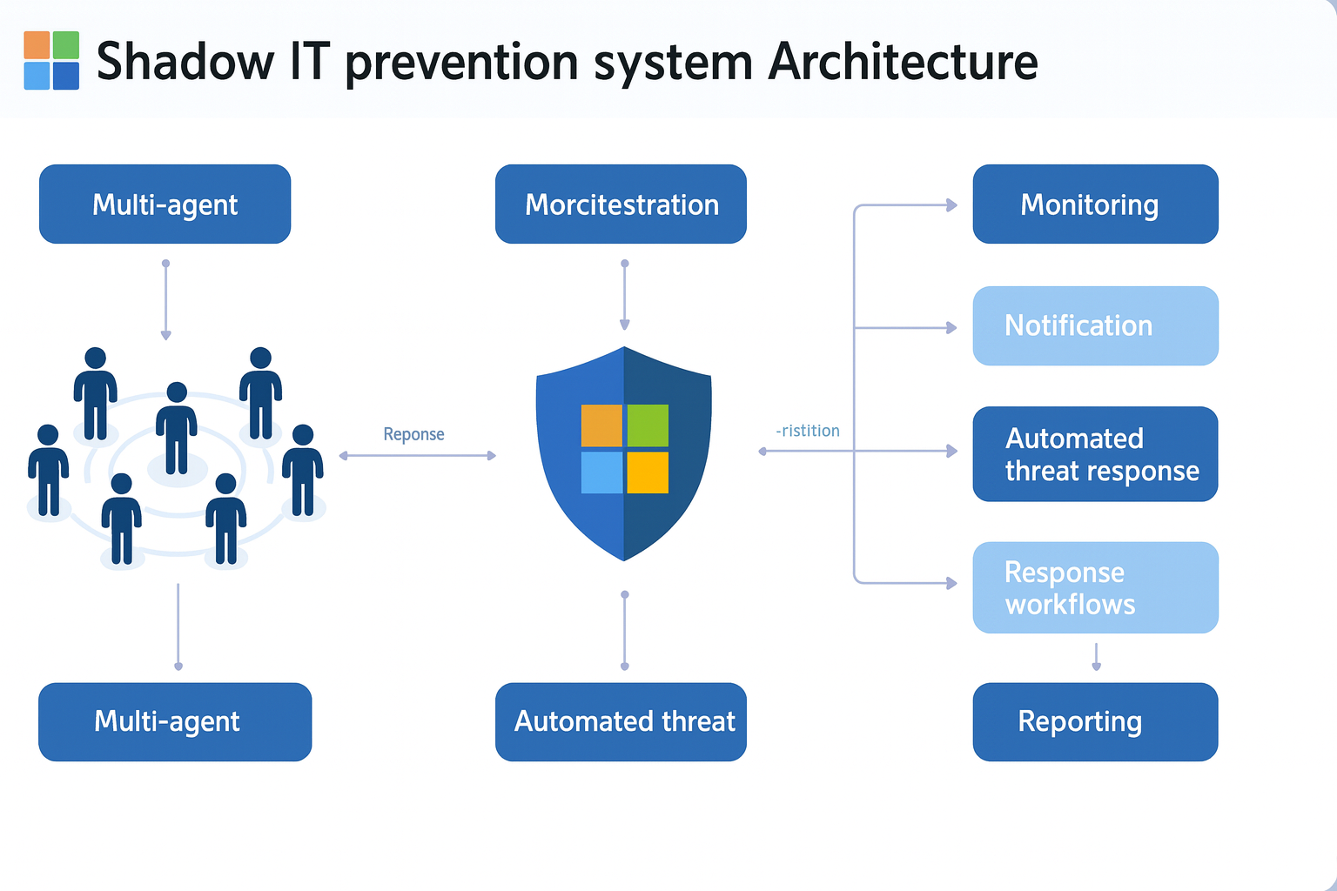
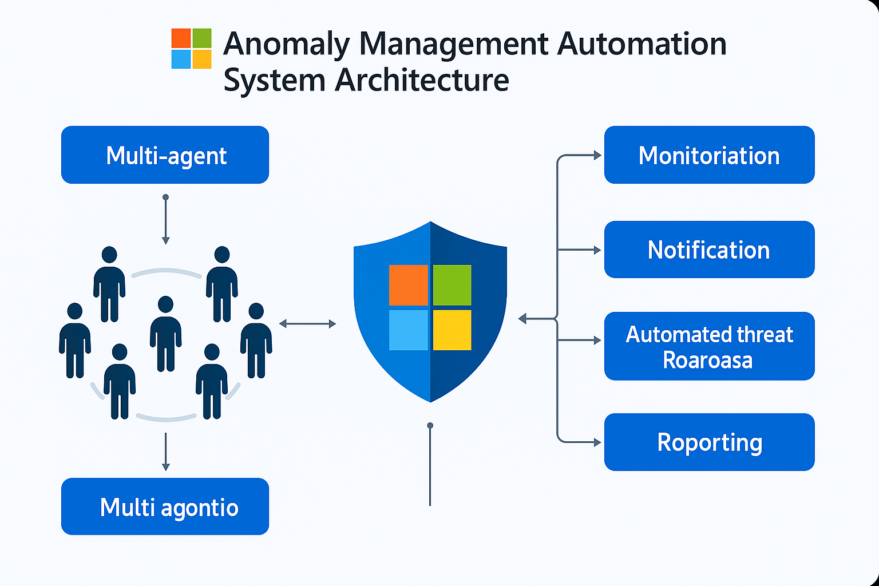
System Architecture
Shadow IT Prevention Architecture
AMAS System Architecture
●
Microsoft Defender integration for comprehensive log analysis and threat detection
●
Azure Functions and CosmosDB for scalable processing and storage
●
Eight specialized agents for role classification and risk evaluation
●
Six specialized agents in sequential pipeline for risk assessment
●
Entra ID integration for seamless access provisioning and management
●
Automated enforcement with human oversight and audit-ready JSON outputs

Slide 19
Technical Implementation
Shadow IT Prevention Technology Stack
AMAS Technology Foundation
Built on Azure AI Studio with Microsoft Defender integration for comprehensive security monitoring and automated threat response capabilities.
Leveraging Azure native services for scalable access management with comprehensive audit capabilities and enterprise-grade security compliance.
●
Azure AI Studio Multi-Agent Foundry for agent orchestration and chaining
●
Azure Functions for serverless agent processing and scalable execution
●
Microsoft Defender for Cloud Apps and Endpoint security data ingestion
●
CosmosDB for immutable audit logging and compliance data storage
●
Azure Sentinel and Entra ID integration for identity and access management
●
Entra ID and Microsoft Graph for seamless identity management integration
●
Azure Functions and Logic Apps for automated workflow execution
●
Logic Apps for workflow automation and escalation management
●
Key Vault and Log Analytics for secure storage and monitoring
●
Application Insights for observability and performance monitoring dashboards

Slide 20


Implementation Roadmap
Phase 1: Foundation Setup
Deploy core Azure infrastructure, establish agent frameworks, integrate Microsoft Defender and Entra ID, and implement basic monitoring and logging capabilities.
Phase 2: Agent Development
Build and test specialized agents for both use cases, implement risk scoring algorithms, establish policy mapping frameworks, and create audit systems.
Phase 3: Security Integration
Deploy automated enforcement mechanisms, implement human oversight workflows, establish escalation procedures, and conduct comprehensive security testing and validation.
Phase 4: Monitoring & Analytics
Implement dashboard UI using React/Foundry, establish ServiceNow integration, deploy real-time API alerts, and create comprehensive reporting and analytics capabilities.

Slide 21
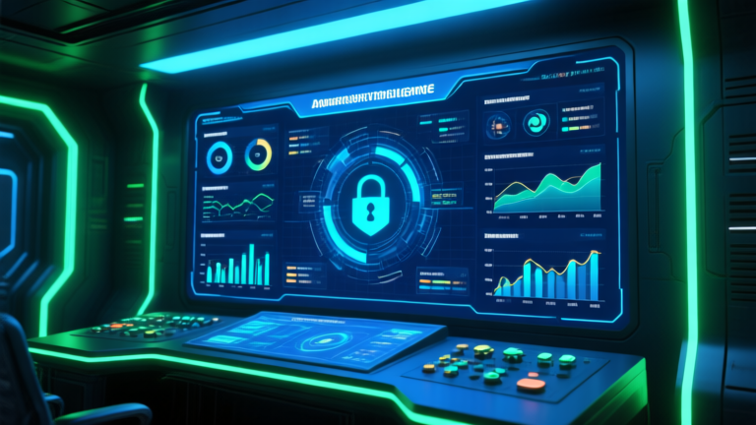
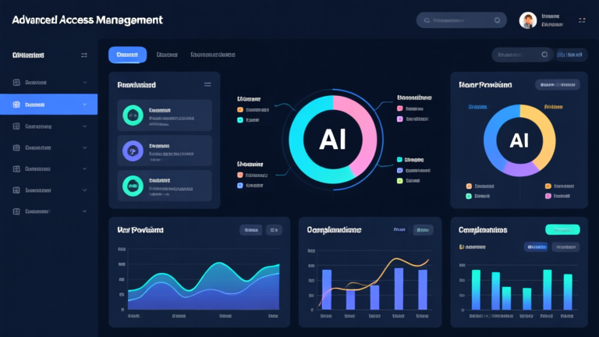
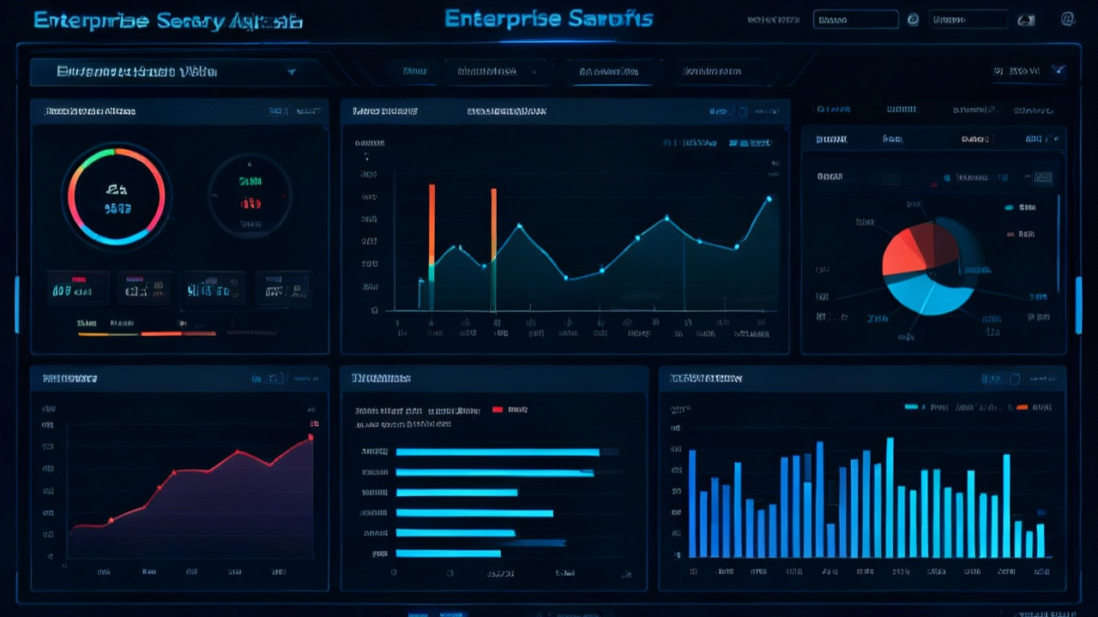
Impact & Future Enhancements
Shadow IT Enhancement
AMAS Evolution
Platform Benefits
●
ServiceNow integration for comprehensive ticket management
●
Enhanced ML models for improved risk prediction
●
Reduced security incidents through proactive threat detection
●
Real-time API alerts for immediate threat notification
●
Advanced dashboard analytics and compliance reporting
●
Improved compliance with automated audit and reporting
●
M365 trace logs integration for enhanced visibility
●
Cross-platform integration with third-party identity providers
●
Enhanced productivity through streamlined access management

Slide 22
Challenges and Learnings
Challenges Faced
Integrating diverse data sources: Normalizing Defender logs, OAuth events, user requests, and Shadow IT signals into a unified structure.
Designing clear agent roles: Ensuring each AI agent handled a specific function without overlap.
Frontend–backend integration: Building a seamless flow between the UI, orchestration layer, and multi-agent system.
API design & communication: Structuring clean, secure, and consistent APIs for agent interaction, automation calls, and final JSON outputs.
Balancing automation with safety: Preventing over-enforcement while maintaining fast, accurate automated actions.
Human-in-loop workflows: Routing high-risk cases without slowing down approvals or overwhelming analysts.
Key Learnings
Multi-agent architecture improves clarity, modularity, and scalability.
Automation requires strong evidence, structured reasoning, and clear policies.
Human oversight is essential for sensitive or high-risk actions.
Unified data models simplify policy mapping, decision-making, and dashboards.
Azure AI Studio accelerates agent orchestration, tool use, and workflow design.

Slide 23

Conclusion
Our project brings together two powerful systems—ASIPD for Shadow IT Prevention and AMAS for Automated Access Management—to create a unified, AI-driven security automation platform. By combining multi-agent intelligence, policy-driven workflows, Microsoft Defender signals, and automated enforcement, we address real enterprise challenges around visibility, governance, and operational efficiency.
This platform demonstrates how AI can streamline complex security processes, reduce manual effort, and strengthen organizational safety while still keeping humans involved where it matters most. Through this build, we learned how automation, thoughtful architecture, and clear policy reasoning can work together to deliver a scalable, reliable security solution for modern enterprises.

Slide 24
"
HERizon transforms enterprise security through intelligent automation, delivering zero-trust security governance with AI-powered efficiency.
— HERizon Vision Statement
This comprehensive platform demonstrates the future of enterprise security operations, where AI agents work collaboratively to detect threats, manage access, and enforce policies while maintaining human oversight and full auditability for regulatory compliance.

Slide 25
Thank You
Questions and discussion about HERizon Security Intelligence Platform implementation and capabilities.

